Slide 1
git (and then some)
Asya Shklyar
March 2018

Slide 2
Does anyone know?
Who wrote git?

Slide 3
Does anyone know who this man this?

Slide 4
Does anyone know?
Who Linus Torvalds is?

Slide 5
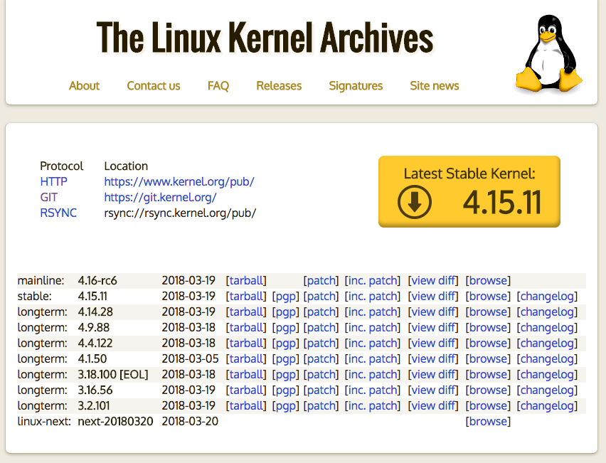
https://www.kernel.org/

Slide 6
https://www.linuxfoundation.org/blog/10-years-of-git-an-interview-with-git-creator-linus-torvalds/
April 6, 2015
Ten years ago this week, the Linux kernel community faced a daunting challenge: They could no longer use their revision control system BitKeeper and no other Source Control Management (SCMs) met their needs for a distributed system. Linus Torvalds, the creator of Linux, took the challenge into his own hands and disappeared over the weekend to emerge the following week with Git. Today Git is used for thousands of projects and has ushered in a new level of social coding among programmers.

Slide 7
https://lwn.net/Articles/130746/
Back in early 1999, your editor got a call from Larry McVoy. He was worried that Linus Torvalds was on the verge of burning out as the kernel project grew. The problems in those days were quite evident; Linus, it was being said, did not scale. But, according to Larry, a complete burnout was not inevitable. If Linus could be given the right tools, many of his problems (and the frustrations of other kernel developers) could be solved, and the system would run smoothly again. The right tool, according to Larry, was a thing called BitKeeper; if some sort of agreement could be made on licensing, Larry (along with his company, BitMover) was willing to make BitKeeper available for kernel development. In fact, Larry wanted to see BitKeeper used for all free software development; see this article from the March 25, 1999 LWN Weekly Edition for a view of how things looked at that time.Three years later, the situation did not look any better. The 2.4 kernel had taken almost a full year to stabilize after 2.4.0 came out. 2.5 had begun, but the process was looking rocky at best. Patches were being dropped, developers were complaining, and Linus was getting tired. After convincing himself that the tool had reached a point where it could do what he needed, Linus decided to give BitKeeper a try. There was no looking back.
FREE BUT PROPRIETARY = NO REVERSE ENGINEERING
NOW BITKEEPER IS AVAILABLE AS OPEN SOURCE (since 2016), TOO LATE, FIGURES
https://news.slashdot.org/story/16/05/10/1840255/11-years-after-git-bitkeeper-is-open-sourced

Slide 8
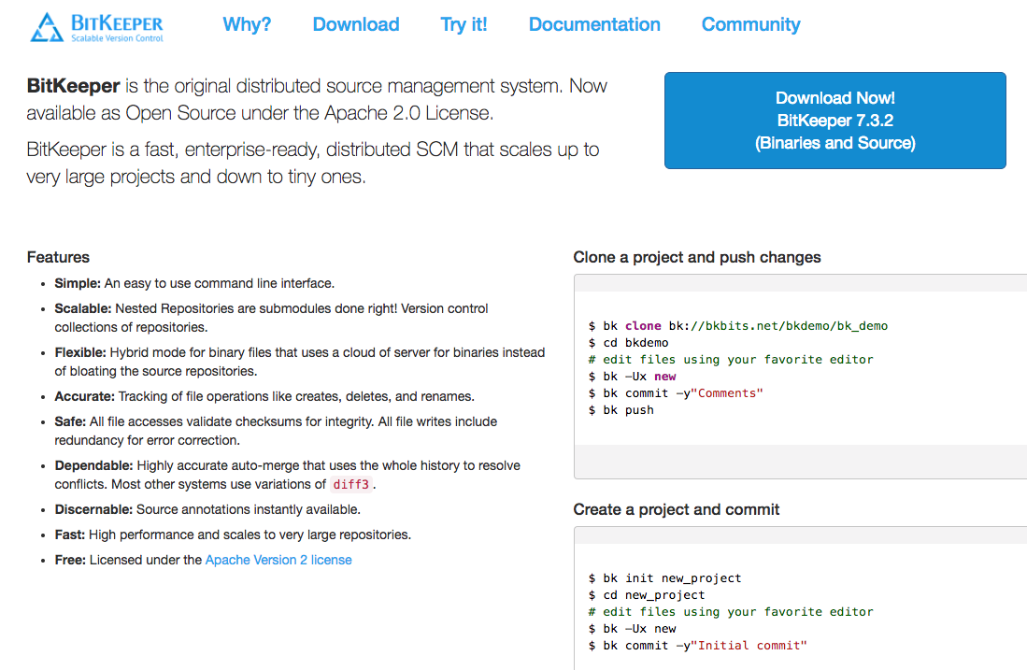
http://www.bitkeeper.org/

Slide 9
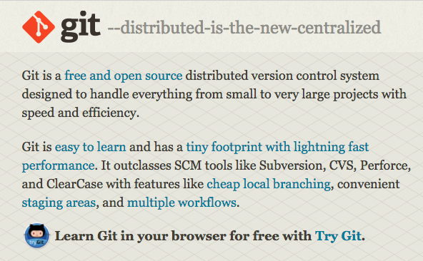
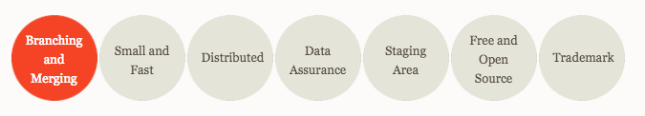
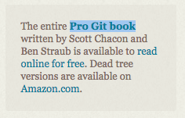
What is git?
https://git-scm.com/
CVS
Subversion or SVN
Mercurial
Perforce
VSS
https://en.wikipedia.org/wiki/Comparison_of_version_control_software

Slide 10
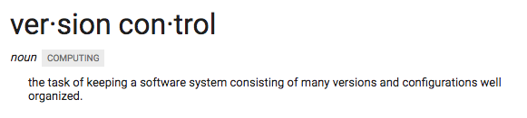
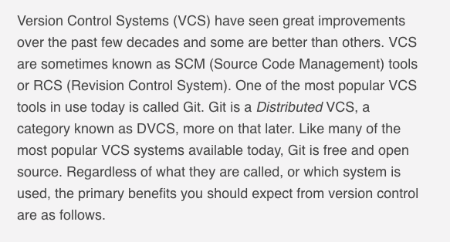
What is version control?
https://www.atlassian.com/git/tutorials/what-is-version-control

Slide 11
Lots of resources that explain both Version Control and git
https://betterexplained.com/articles/a-visual-guide-to-version-control/
https://try.github.io/levels/1/challenges/1
https://learngitbranching.js.org/
https://www.codecademy.com/learn/learn-git
https://www.codeschool.com/courses/try-git
http://git.rocks/

Slide 12
Distraction 1: lively debates about mercurial vs git
https://jhw.dreamwidth.org/1868.html
Family History vs Change Lineage
“Clean History”, “Safer History”
Rebasing vs Merging
https://www.atlassian.com/blog/git/git-vs-mercurial-why-git
https://content.intland.com/blog/sdlc/why-is-git-better-than-mercurial

Slide 13
Distraction 2: is git blockchain?
https://medium.com/@shemnon/is-a-git-repository-a-blockchain-35cb1cd2c491
Truly a linked list, at internet scale.
https: //stackoverflow.com/questions/46192377/why-is-git-not-considered-a-block-chain
Uses Merkle trees, hashes but that existed since the 70s
A merkle tree is a tree where each node is labeled with the cryptographic hash value of their contents, which includes the labels of its children.
In a blockchain implementation, every block is verified independently multiple times before it is added to the blockchain. This is indeed one of the most important things about blockchain technology and is what ensures its "unhackability."
You can rewrite git history.
Blockchain is when there is a way of determining the main chain when two or more are diverted, and when no central authority is needed for that determination.

Slide 14
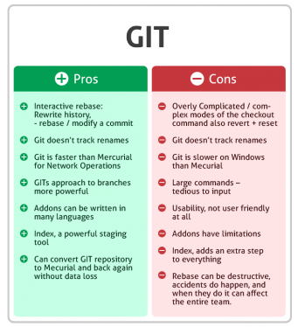
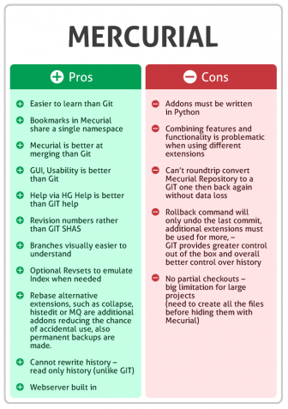

Slide 15
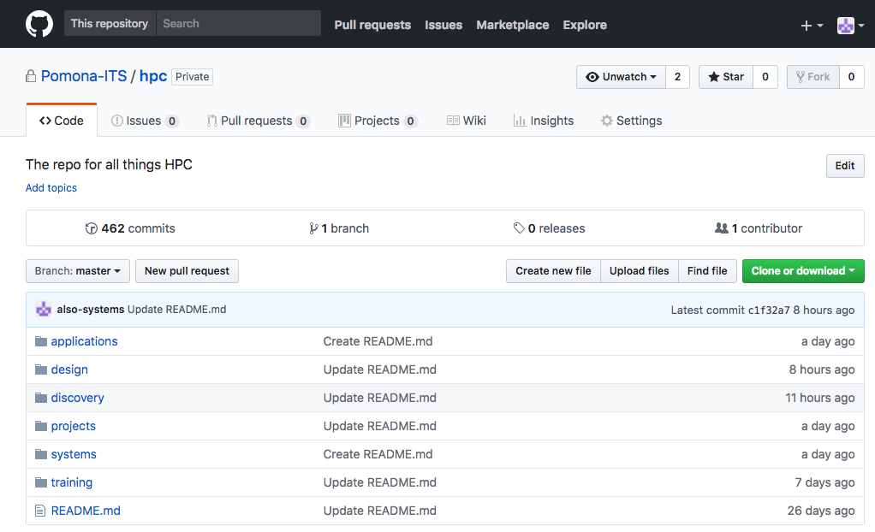
Ecosystem
GitHub
GitLab
Gist
Atlassian Suite…
BitBucket
Codeship
Stash
AWS
CodeCommit
CircleCI, Jenkins, GoCD, Travis
https://github.com/Pomona-ITS/hpc
https://www.labnol.org/internet/github-gist-tutorial/28499/

Slide 16
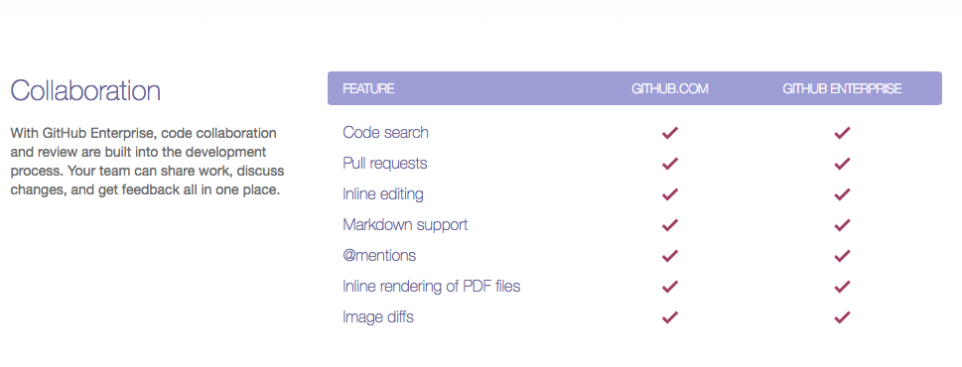

Slide 17
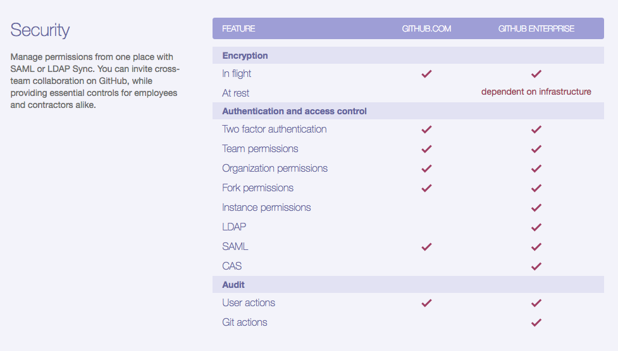

Slide 18
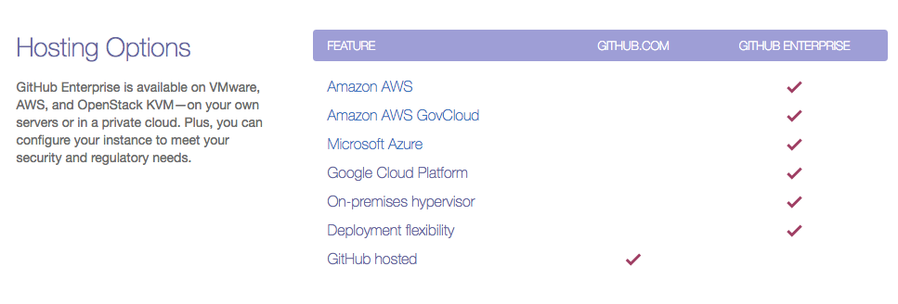

Slide 19
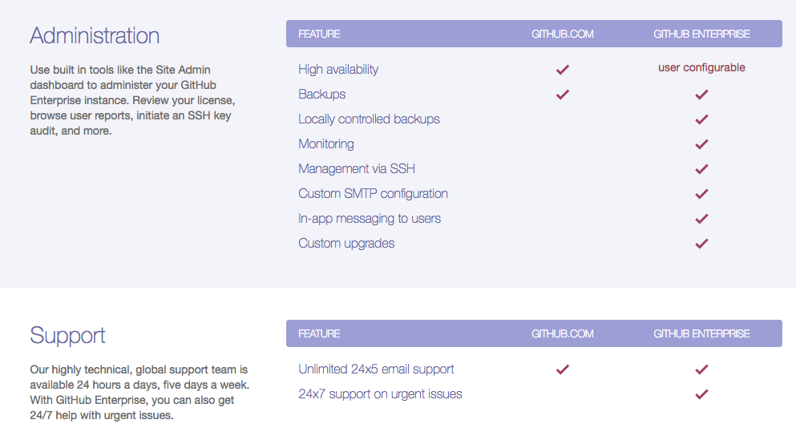

Slide 20
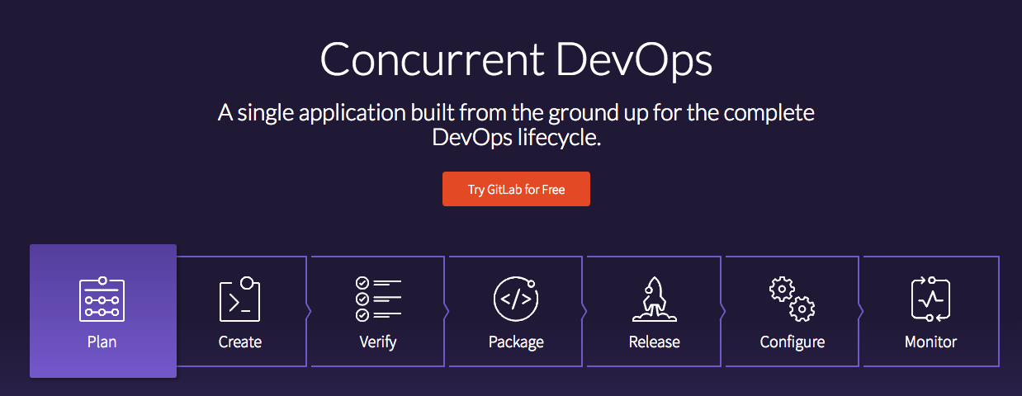
https://about.gitlab.com/

Slide 21
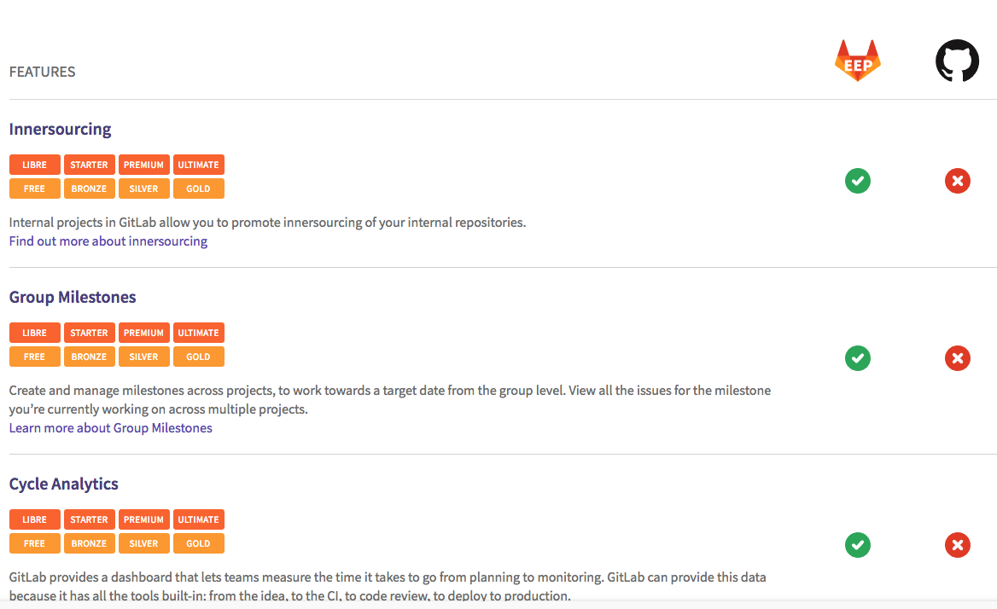
GitLab Premium vs GitHub Enterprise
https://about.gitlab.com/comparison/gitlab-eep-vs-github-enterprise.html

Slide 22
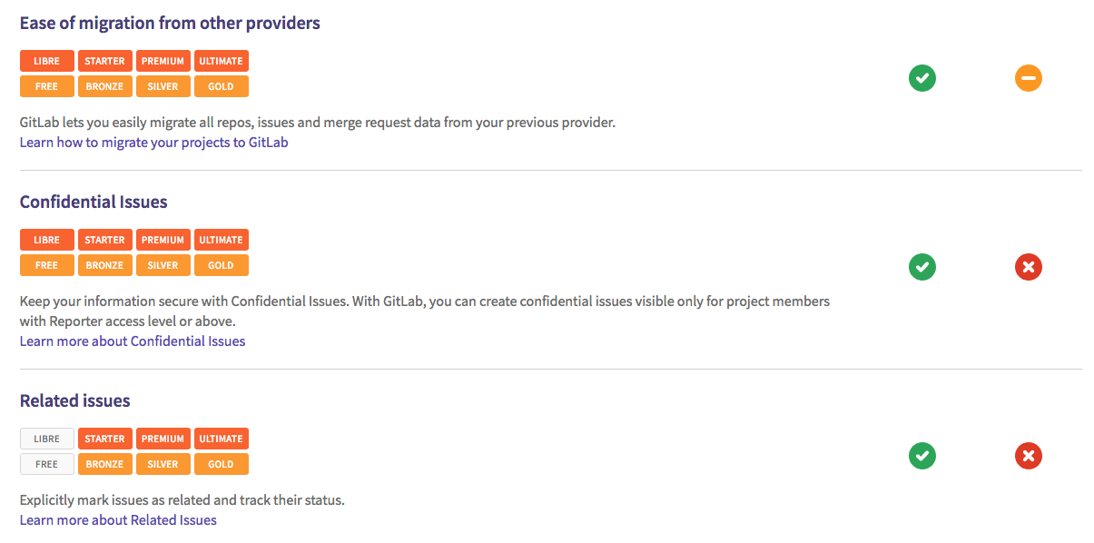

Slide 23
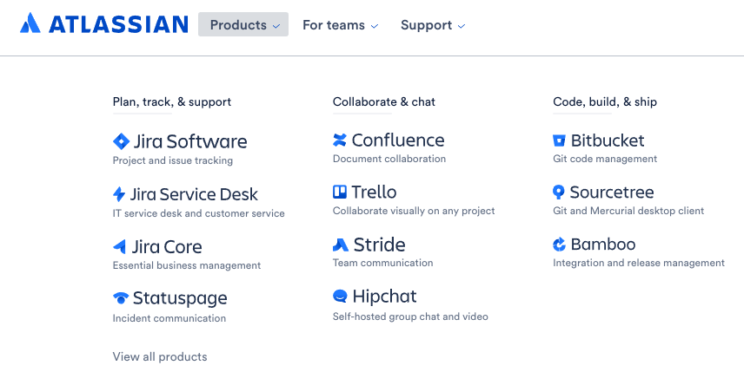

Slide 24
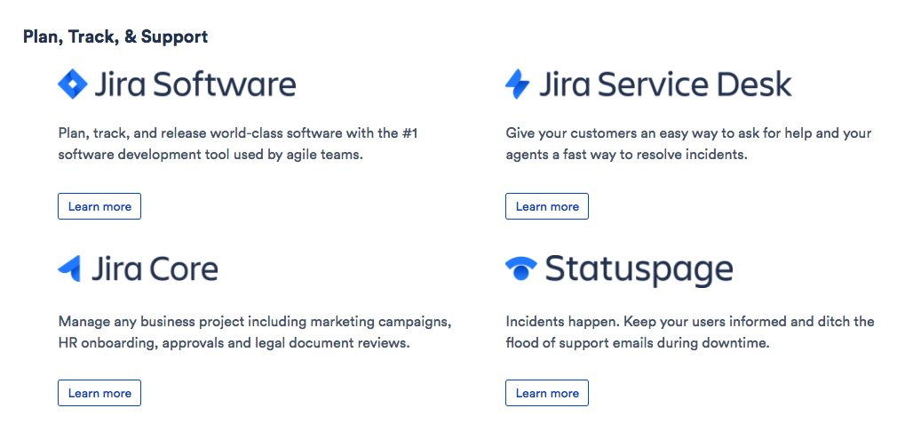

Slide 25
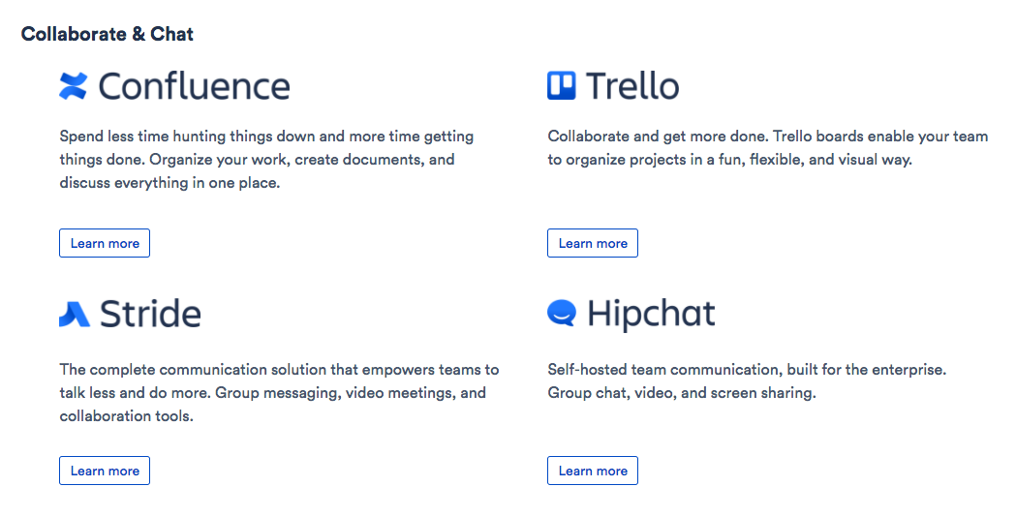

Slide 26
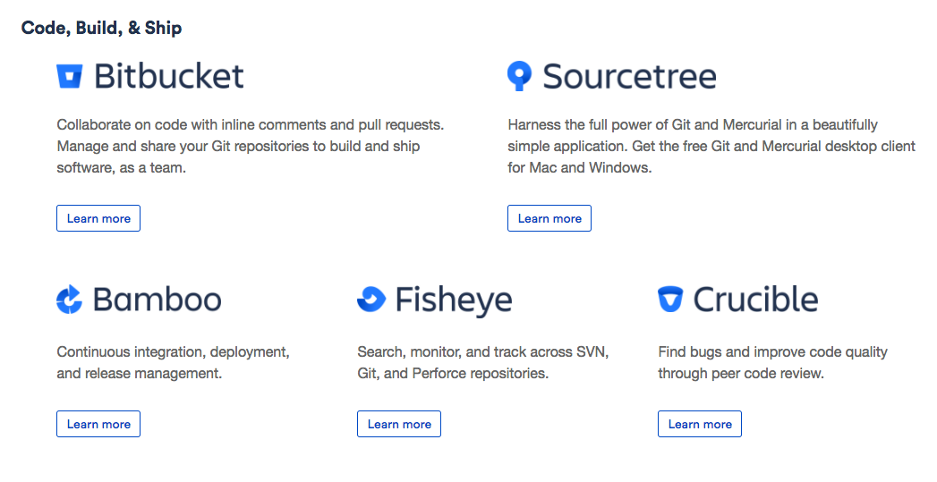

Slide 27
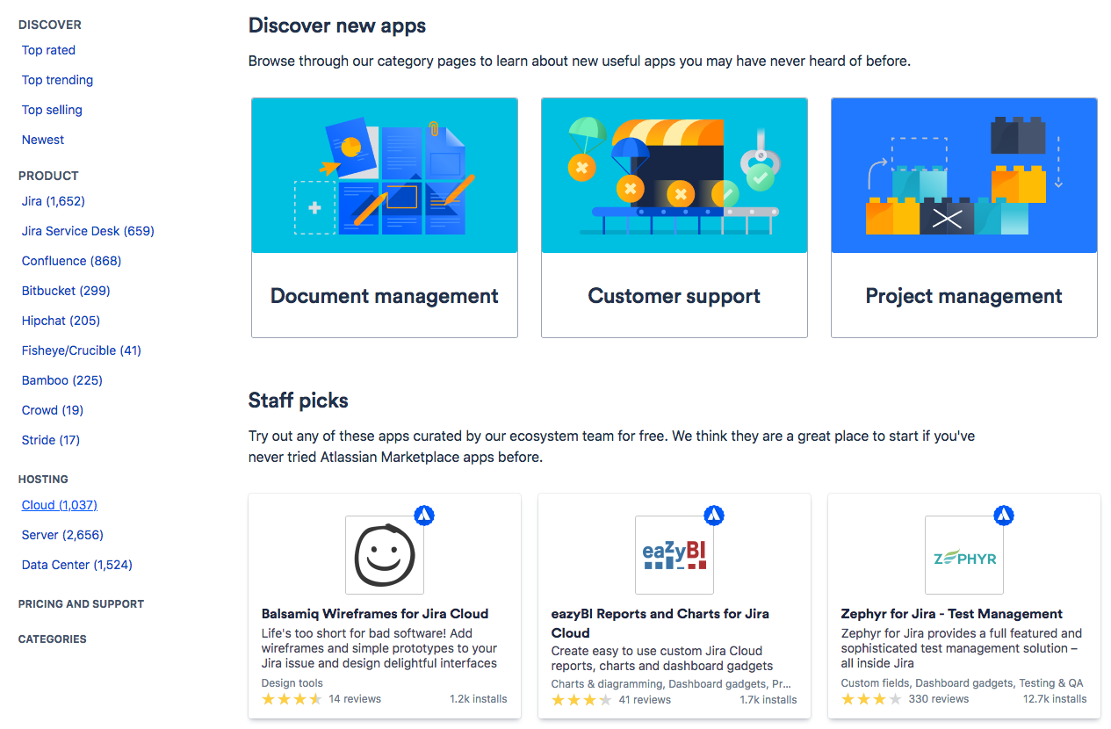
https://marketplace.atlassian.com/

Slide 28
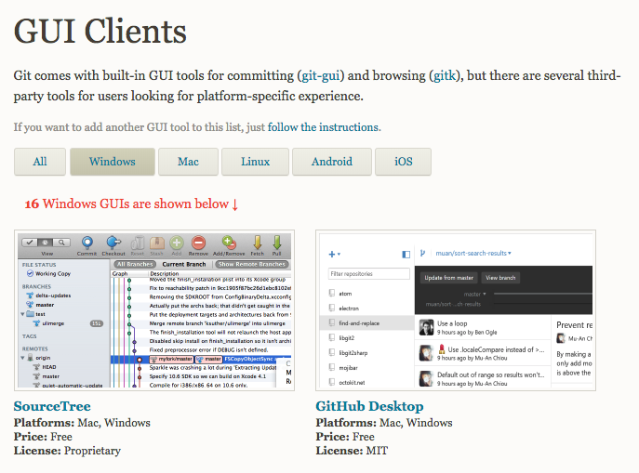
Command Line or GUI or Web! Or Mobile!
https://git-scm.com/download/gui/linux
https://git-scm.com/download/gui/mac
https://git-scm.com/download/gui/windows
https://git-scm.com/docs/git-gui
https://git-scm.com/docs/gitk
https://git.wiki.kernel.org/index.php/InterfacesFrontendsAndTools

